Slide 1




Team 5
November 19, 2020
First
Delivery
Antonietta Napoli
Antonella Rossi
Simona Sorgente
Angelo Vistocco

Slide 2


Team 5
November 19, 2020
Today's Agenda
1
Sprint 1
3
The MVC Architecture
2
Sprint 2
4
Architecture Developed

Slide 3




US2
Record maintenance data
US3
View scheduled maintenance activities list
US1
Manage maintenance activities
Sprint Backlog
Sprint
1
US4
View scheduled maintenance activities informations
US19-24
Manage procedure maintenance data
US5
US10
Create the link between the previous views
Make possible to insert workspace notes

Slide 4
US7
Select a time slot for the maintainer
US6
Select a Maintainer from a list of maintainers
US8
Sprint Backlog
View for selected activity and selected maintainer
Sprint
2
US13-14
Manage users and Maintainers competencies
US9
Send a notification to the selected Maintainer and to the Production manager

Slide 5

The MVC Architecture
1
Model
Manages the persistence and access to data. It is responsible for notifying the views whenever the data changes
2
View
Registers with the model, can modify the model and responds to changes in the model by redrawing itself
The MVC is a 3-tier model and a popular way of organizing GUI programs that need to display several different views of data.
The main idea is to separate the data from the display.
In this way, a programmer can focus on a specific problem, with the safety that each code intervention will not affect other parts of the program.
3
Controller
Manages user interactions and the exchange of data between view and model

Slide 6
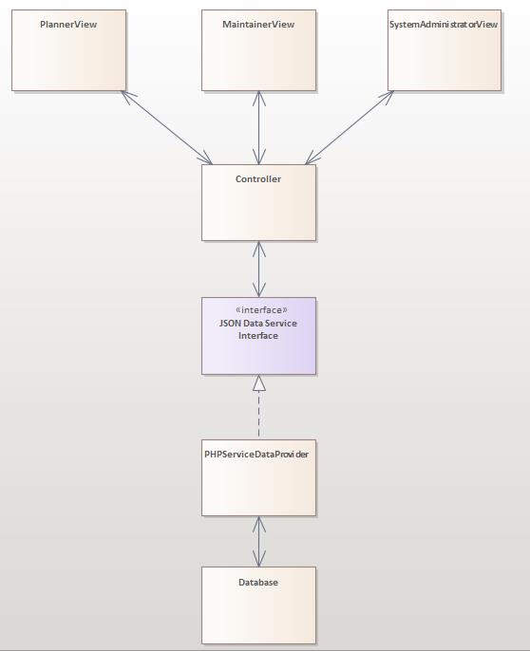
Architecture Developed
This high-level MVC architecture provides an overview of the web application we need to implement.
There are three views, one for each role identified in the Requirements Process: Planner, Maintainer and System Administrator.
The controller, gathers input from the user and send message to the Model.
A JSON (JavaScript Object Notation) Interface is used to exchange data between client and server.
We also use PHP as a Service Data Provider to interact with the data repository.

